Slide 1
CoolTShirts
Marketing Campaign Review

Slide 2
CoolTShirts
Campaigns
Getting to know CoolTShirts
Weekly Newsletter
Ten Crazy CoolTShirt Facts
Interview with CoolTShirts Founder
Retargeting Campaign
Retargeting Ad
Paid Search
CoolTShirt Search

Slide 3
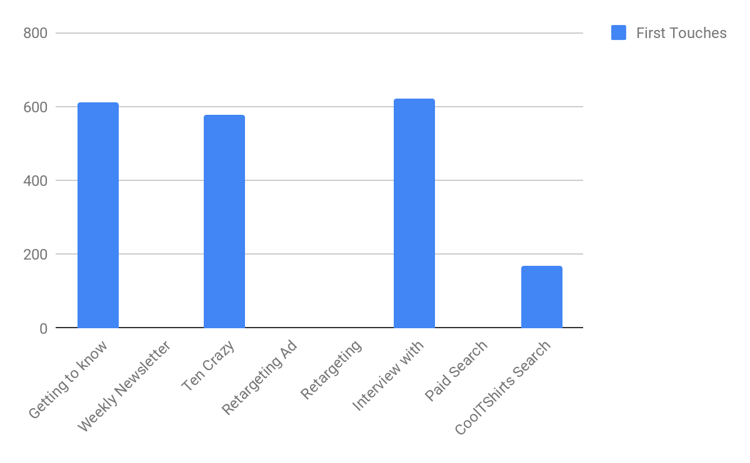
CoolTShirts - First Touches

Slide 4
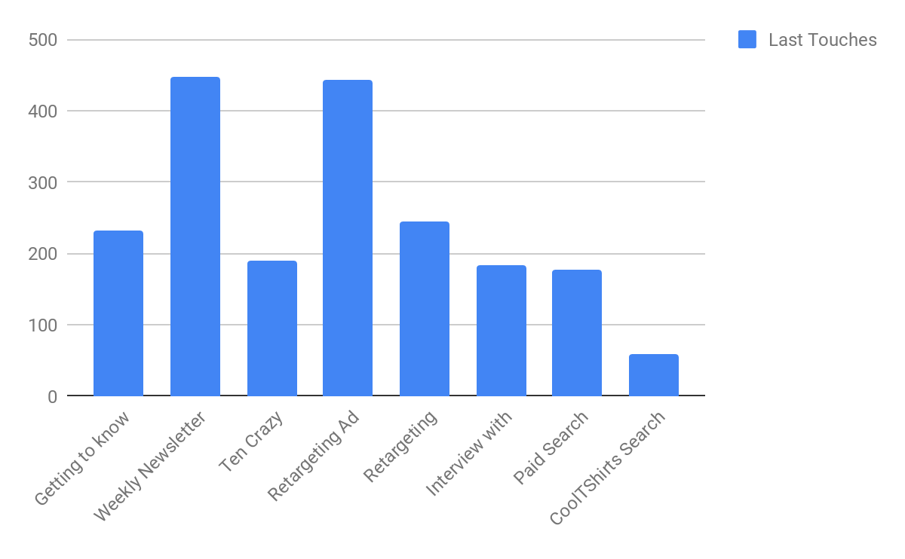
CoolTShirts - Last Touches

Slide 5
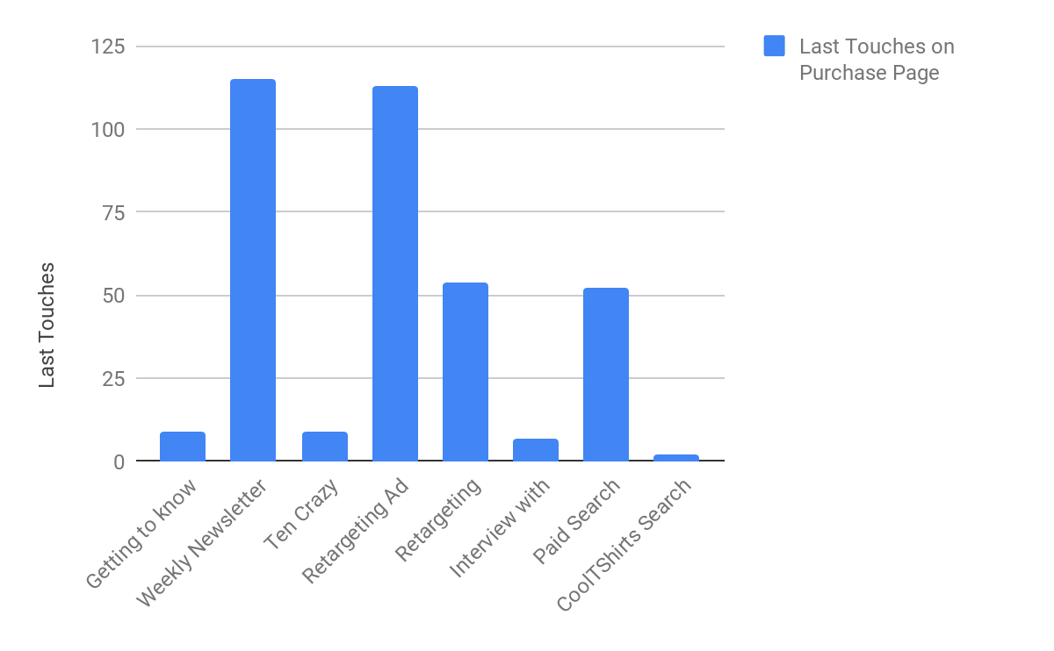
CoolTShirts - Last Touches On Purchase Page

Slide 6
CoolTShirts
Findings
Of all these first and last touches, 361 visitors made a purchase;
I would recommend reinvesting in one more larger profile item such as the Getting to Know CoolTShirts
I would also recommend investing in several more retargeting campaigns which had an average purchase rate of 23.8%
The Paid Search was also a good choice with a 29.2% purchase rate on last touches and the weekly newsletter generated a 25.7% purchase rate

Slide 7
CoolTShirts

